Slide 1
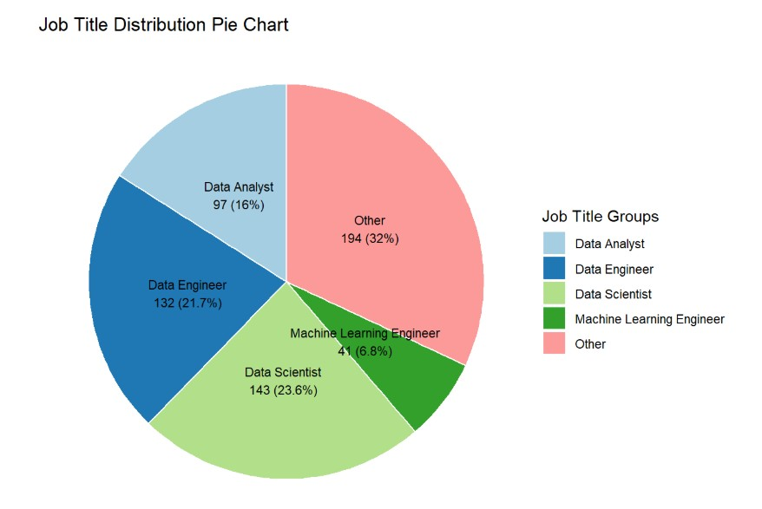
Hiring a Data Scientist
Name Soup
Notes:
Finding a Data Scientist is to hire for our organization requires us to understand what skills we need in order to accomplish our data needs.

Slide 2
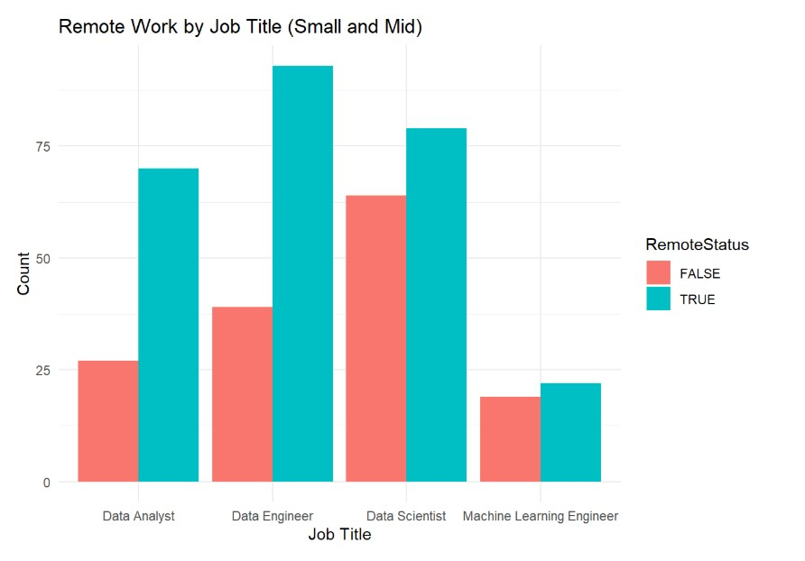
Remote
Vs Non-Remote
Counts by popular Job Titles
Notes:
Data scientist and Machine Learning Engineers seem to be about 20% less remote. Data Engineers have the highest mean salary. Data Scientists lead in remote work population. Data Engineers earn more on average than Data Analysts, with the true difference likely in that $7k–$32k range with 95% confidence

Slide 3
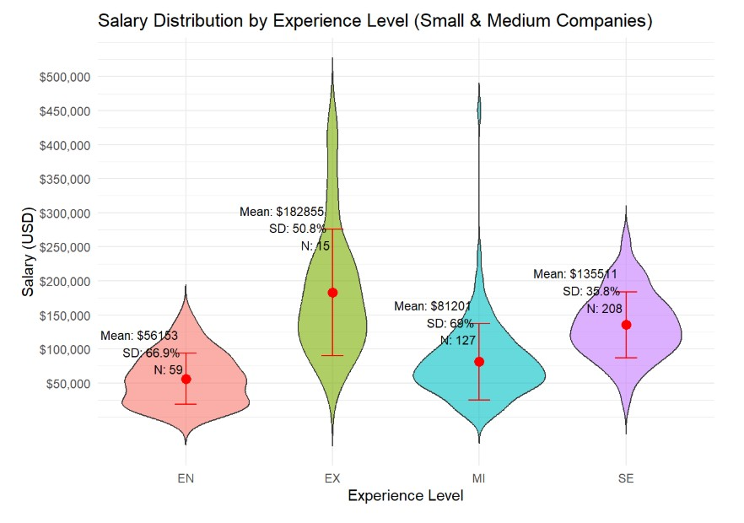
Full Time
Salary
Distribution by
Experience Level
Notes:
The lower counts were statistically bolstered by merging the medium size business category, giving good ranges for Senior and Mid experience levels, although these numbers are skewed lower by international distribution of the data set. US employers trend higher, therefore.

Slide 4
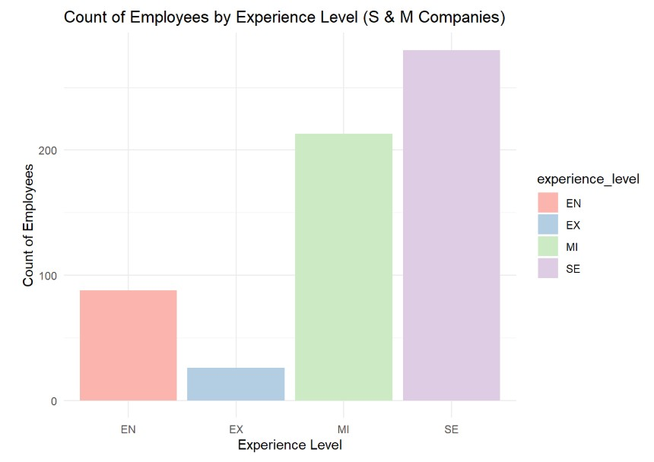
Behind the numbers
Experience level count for small and medium size businesses

Slide 5
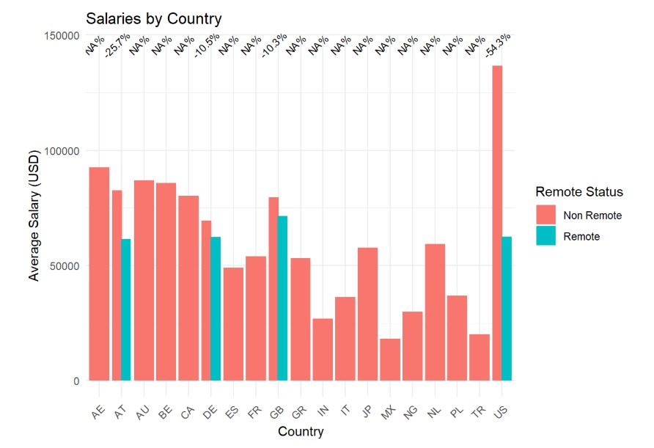
Supplemental: Distribution by country
Notes:
US salary is higher than the whole group, also majority of population in sample

